Slide 1

Artificial Intelligence
4 Beyond Classical Search
Russell & Norvig, AI: A Modern Approach, 3rd Ed
(Local Search)
Lec Zinia Sultana
CSE Dept, MIST

Slide 2
Search Heuristics
Local search techniques and optimization
Hill-climbing
Simulated annealing
Local Beam Search
Genetic algorithms
Issues with local search

Slide 3
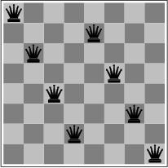
Local search and optimization
Previously: systematic exploration of search space.
Path to goal is solution to problem
YET, for some problems path is irrelevant.
E.g 8-queens
Different algorithms can be used
Local search

Slide 4
Local search and optimization
Applications:
Integrated-circuit design
Factory-floor layout
Job-shop scheduling
Automatic programming
Telecommunications
Network Optimization
Vehicle Routing

Slide 5
Local search and optimization
Local search
Keep track of single current state
Move only to neighboring states
Ignore paths
Advantages:
Use very little memory (Usually Constant Amount)
Can often find reasonable solutions in large or infinite (continuous) state spaces.

Slide 6
Local search and optimization
Local Search algorithms are very useful for solving “Pure Optimization” problems.
“Pure optimization” problems
All states have an objective function (OF)
Goal is to find state with max (or min) objective value
Does not quite fit into path-cost/goal-state formulation
Local search can do quite well on these problems.

Slide 7
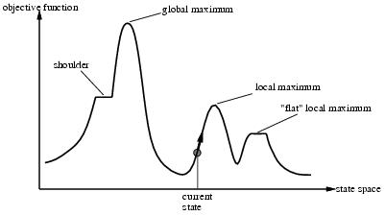
“Landscape” of search
A complete local search algorithm always finds a goal if one exists!!

Slide 8
Hill-climbing search
function HILL-CLIMBING( problem) return a state that is a local maximum
input: problem, a problem
local variables: current, a node.
neighbor, a node.
current ← MAKE-NODE(INITIAL-STATE[problem])
loop do
neighbor ← a highest valued successor of current
if VALUE [neighbor] ≤ VALUE[current] then return STATE[current]
current ← neighbor

Slide 9
Hill-climbing (Steepest-Ascent Version) search
“A loop that continuously moves in the direction of increasing value” – to Uphill
terminates when a peak is reached
Aka greedy local search
Value can be either
Objective function value
Heuristic function value
Hill climbing does not look ahead of the immediate neighbors of the current state.
Can randomly choose among the set of best successors, if multiple have the best value
Characterized as “trying to find the top of Mount Everest in a thick fog while suffering from amnesia”

Slide 10
Hill climbing and local maxima
When local maxima exist, hill climbing is suboptimal
Simple (often effective) solution
Multiple random restarts

Slide 11
Hill-climbing example
8-queens problem, complete-state formulation
All 8 queens on the board in some configuration
Successor function:
move a single queen to another square in the same column.
Example of a heuristic function h(n):
the number of pairs of queens that are attacking each other (directly or indirectly)
(so we want to minimize this)

Slide 12
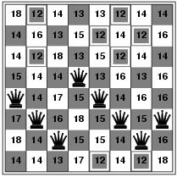
Hill-climbing example
Current state: h=17
Shown is the h-value for each possible
successor in each column

Slide 13
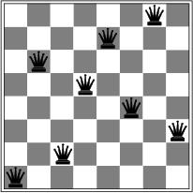
A local minimum for 8-queens
A local minimum in the 8-queens state space (h=1)

Slide 14
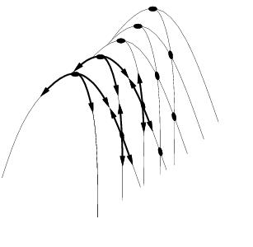
Other drawbacks
Ridge = sequence of local maxima difficult for greedy algorithms to navigate
Plateau = an area of the state space where the evaluation function is flat.

Slide 15
Performance of hill-climbing on 8-queens
Randomly generated 8-queens starting states…
14% the time it solves the problem
86% of the time it get stuck at a local minimum
However…
Takes only 4 steps on average when it succeeds
And 3 on average when it gets stuck
(for a state space with ~17 million states)

Slide 16
Possible solution…sideways moves
If no downhill (uphill) moves, allow sideways moves in hope that algorithm can escape
Need to place a limit on the possible number of sideways moves to avoid infinite loops
For 8-queens
Now allow sideways moves with a limit of 100
Raises percentage of problem instances solved from 14 to 94%
However….
21 steps for every successful solution
64 for each failure

Slide 17
Hill-climbing variations
Stochastic hill-climbing
Random selection among the uphill moves.
The selection probability can vary with the steepness of the uphill move.
Usually converges more slowly than steepest-ascent but in some state space, it finds better solutions
First-choice hill-climbing
stochastic hill climbing by generating successors randomly until a better one is found
Useful when there are a very large number of successors
Random-restart hill-climbing
Tries to avoid getting stuck in local maxima.

Slide 18
Hill-climbing with random restarts
Different variations
For each restart: run until termination v. run for a fixed time
Run a fixed number of restarts or run indefinitely
Analysis
Say each search has probability p of success
E.g., for 8-queens, p = 0.14 with no sideways moves
Expected number of restarts?
Expected number of steps taken?

Slide 19
Expected number of restarts
Probability of Success = p
Number of restarts = 1 / p
This means 1 successful iteration after (1/p – 1) failed iterations
Let avg. number of steps in a failure iteration = f
and avg. number of steps in a successful iteration = s
Therefore, expected number of steps in random-restart hill climbing = 1 * s + (1/p – 1) f
So for 8-queens, p = 14%, s = 4, f = 3,
Expected no of moves = 1 * 4 + (1/0.14 -1) * 3 = 22
With sideways moves, p = 94%, s = 21, f = 64
Expected no of moves = 1 * 21 + (1/0.94 -1) * 64 = 25

Slide 20
Local beam search
Keep track of k states instead of one
Initially: k randomly selected states
Next: determine all successors of k states
If any of successors is goal → finished
Else select k best from successors and repeat.
Major difference with random-restart search
Information is shared among k search threads.
Can suffer from lack of diversity.
Stochastic beam search
choose k successors proportional to state quality (randomly).

Slide 21
Search using Simulated Annealing
Simulated Annealing = hill-climbing with non-deterministic search (random walk)
Basic ideas:
like hill-climbing identify the quality of the local improvements
instead of picking the best move, pick one randomly
say the change in objective function is d
if d is positive, then move to that state
otherwise:
move to this state with probability proportional to d
thus: worse moves (very large negative d) are executed less often
however, there is always a chance of escaping from local maxima

Slide 22
Physical Interpretation of Simulated Annealing
A Physical Analogy:
Imagine letting a ball roll downhill on the function surface
this is like hill-climbing (for minimization)
Now imagine shaking the surface, while the ball rolls, gradually reducing the amount of shaking
this is like simulated annealing
If we shake the surface, we can bounce the ball out of local minimum but hard enough to dislodge from global minimum
Annealing = physical process used to temper or harden metals glass by heating them to a high temperature and then gradually cooling them, thus allowing the material to reach a low-energy crystalline state.

Slide 23
Simulated annealing
function SIMULATED-ANNEALING( problem, schedule) return a solution state
input: problem, a problem
schedule, a mapping from time to temperature
local variables: current, a node.
next, a node.
T, a “temperature” controlling the probability of downward steps
current ← MAKE-NODE(INITIAL-STATE[problem])
for t ← 1 to ∞ do
T ← schedule[t]
if T = 0 then return current
next ← a randomly selected successor of current
∆E ← VALUE[next] - VALUE[current]
if ∆E > 0 then current ← next
else current ← next only with probability e^{∆E /T}

Slide 24
More Details on Simulated Annealing
Lets say there are 3 moves available, with changes in the objective function of d1 = -0.1, d2 = 0.5, d3 = -5. (Let T = 1).
pick a move randomly:
if d2 is picked, move there.
if d1 or d3 are picked, probability of move = exp(d/T)
move 1: prob1 = exp(-0.1) = 0.9,
i.e., 90% of the time we will accept this move
move 3: prob3 = exp(-5) = 0.05
i.e., 5% of the time we will accept this move
T = “temperature” parameter
high T => probability of “locally bad” move is higher
low T => probability of “locally bad” move is lower
typically, T is decreased as the algorithm runs longer
i.e., there is a “temperature schedule”

Slide 25
Simulated Annealing in Practice
Method proposed in 1983 by IBM researchers for solving VLSI layout problems (Kirkpatrick et al, Science, 220:671-680, 1983).
theoretically will always find the global optimum (the best solution)
Useful for some problems, but can be very slow
Slowness comes about because T must be decreased very gradually to retain optimality
In practice how do we decide the rate at which to decrease T? (this is a practical problem with this method)

Slide 26
Genetic Algorithms (GA)
Different approach to other search algorithms
A successor state is generated by combining two parent states rather than modifying the current state (sexual reproduction rather than asexual reproduction)
A state is represented as a string over a finite alphabet (e.g. most commonly 0s and 1s, binary)
8-queens
State = position of 8 queens each in a column
=> 8 x log(8) bits = 24 bits (for binary representation)
Alternatively, the state could be represented as digits, ranges 1 to 8
Like Beam Search, GA starts with k randomly generated states (called the population)
Objective function (fitness function).
Should return higher values for better states.
Opposite to heuristic function, e.g., # non-attacking pairs in 8-queens
Produce the next generation of states by “simulated evolution”
Random selection
Crossover
Random mutation

Slide 27
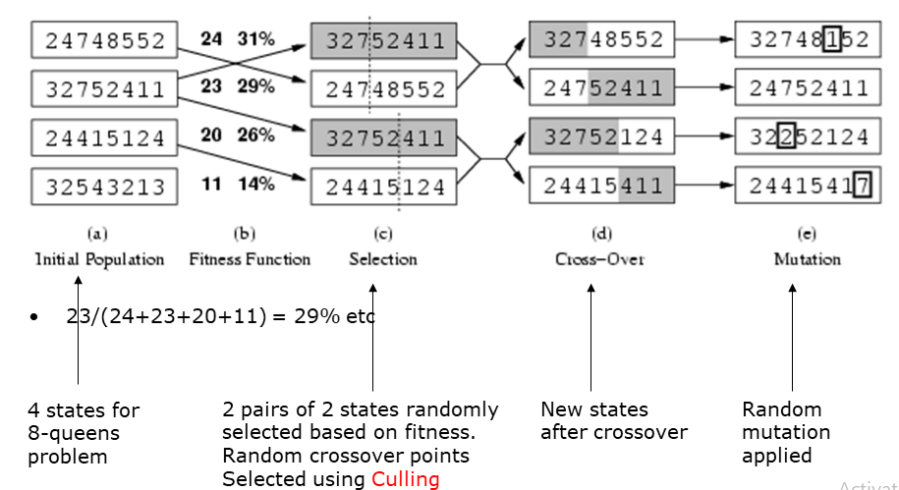
Genetic algorithms

Slide 28
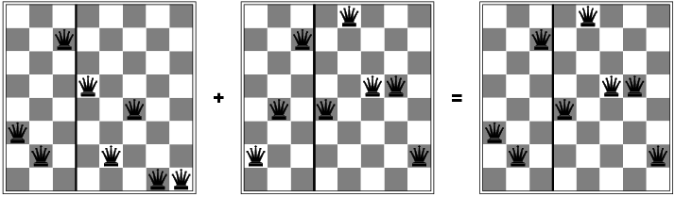
Genetic algorithms
Has the effect of “jumping” to a completely different new part of the search space (quite non-local)

Slide 29
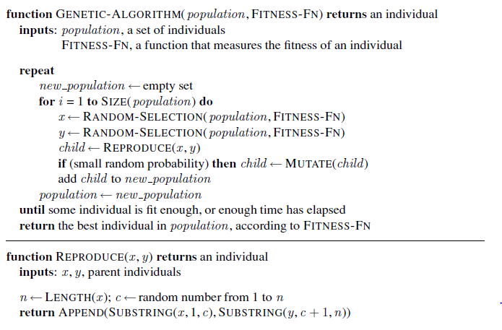
Genetic algorithm pseudocode

Slide 30
Comments on genetic algorithms
Positive points
Random exploration can find solutions that local search can’t
(via crossover primarily)
Appealing connection to human evolution
E.g., see related area of genetic programming, Bioinformatics
Negative points
Large number of “tunable” parameters
Difficult to replicate performance from one problem to another
Lack of good empirical studies comparing to simpler methods
Useful on some (small?) set of problems but no convincing evidence that GAs are better than hill-climbing w/random restarts in general

